Slide 1
API BUILDER

Slide 2
Table of Content
Project Brief
Problem Statement
Project Objective and Scope
Methodology and Interpretation
Problem Analysis
Prospects
Questions and Feedback

Slide 3
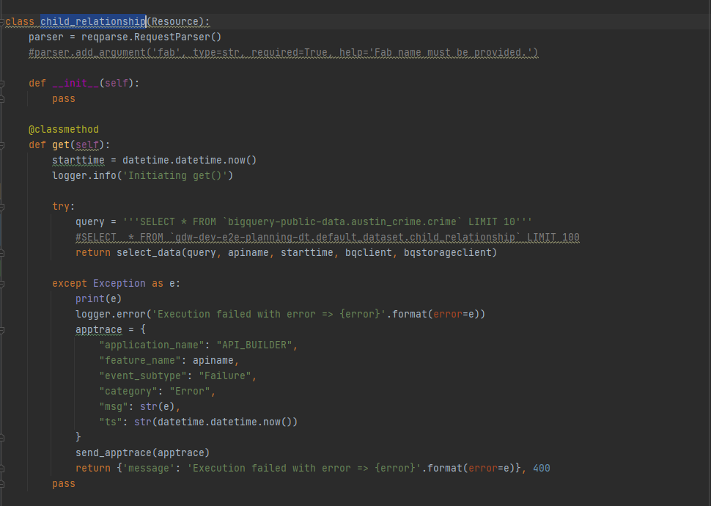
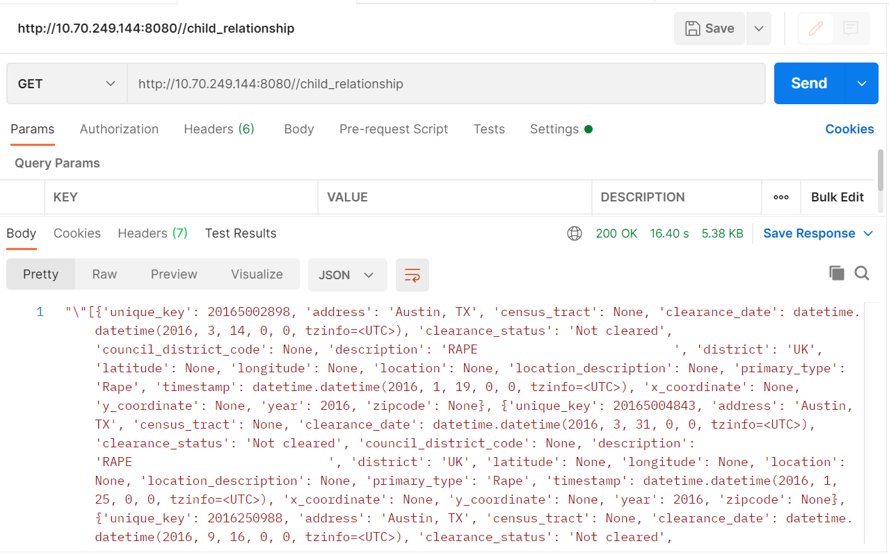
Project Brief
What is an API
An API for a website is code that allows two software programs to communicate with each other. The API spells out the proper way for a developer to write a program requesting services from an operating system or other application
When to create an api
Your data set is large, making download via FTP unwieldy or resource-intensive.
Your users will need to access your data in real time, such as for display on another website or as part of an application.
Your data changes or is updated frequently.
Your users only need access to a part of the data at any one time.

Slide 4
Problem Statement
Each time we want to create an API we have to write the code for it which is a redundant task and involves programming knowledge. Creating API in bulk is also a limitation

Slide 5
Project Objective and Scope
Build generic framework to easily access/fetch data from various data sources with the help of APIs without much of programming experience. All user needs to provide is the source details in a simple and intuitive web ui and able to build the APIs in large numbers in less time. Integration with the error logging and metrics monitoring tools such as PIMA, Auto deployment etc.
API Builder is a framework, enables to create API’s seamlessly with simple web user interface and integrated with PIMA monitoring tool for logging and alerts, Auto committing the created APIs, Enabled with Data Validations and Auto-deployments. This framework helps to create 100’s of APIs in just few minutes and lessen the API development and deployment times, which helps to get projects onboarded in very short time. This API Builder Framework support CRUD operations, Imports and export features as well

Slide 6
Project Objective and Scope
Based on Free form SQL queries to enable and larger user base to build any API to reduce the development effort.
We can provision this system for entire micron developers who wants to build any api. This tool can reduce months of works for api development into days including development, testing and production deployment

Slide 7
Methodology and Interpretation
This tool uses simple HTML, CSS and Java Script web page that can be manipulated/customized based on requirements easily. In the backend, flask application in python is writing the APIs based on user’s request and for the deployment, OpenShift is the containerized platform that can handle thousands of requests seamlessly with its autoscaling feature

Slide 8
Problem Analysis
Will write it later

Slide 9
Prospects
In future work, enable this tool for all organizational API needs to support all widely used data sources at Micron like GDW, Snowflake, GCP, RDBMS etc.

